Slide 1
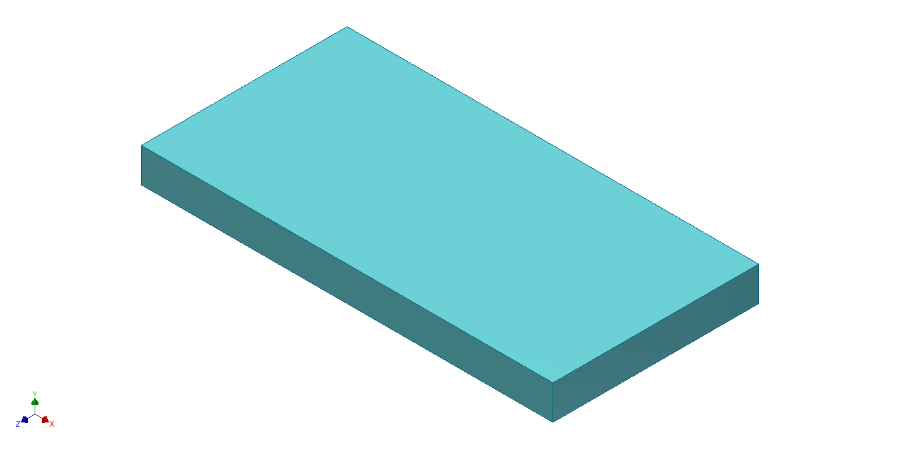
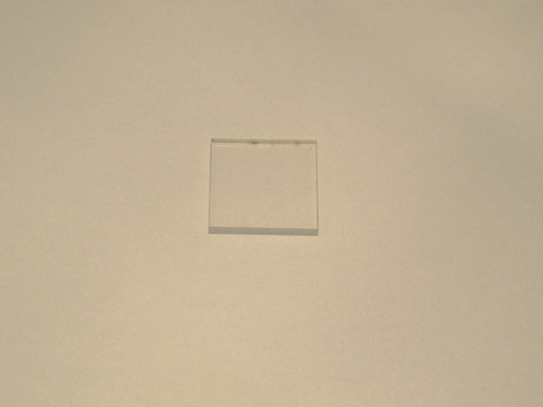
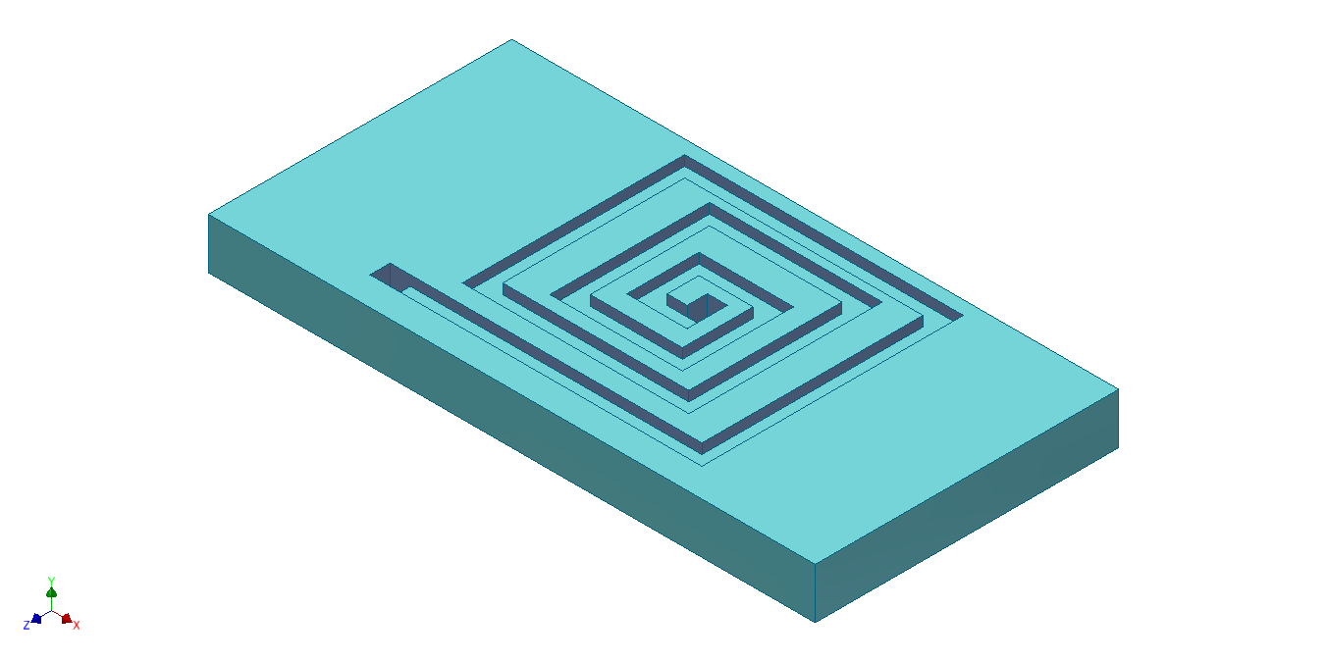
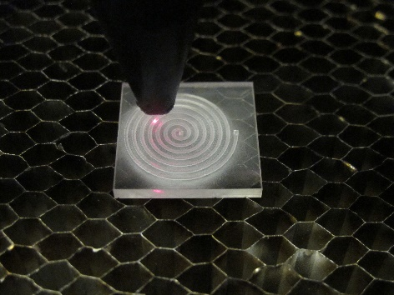
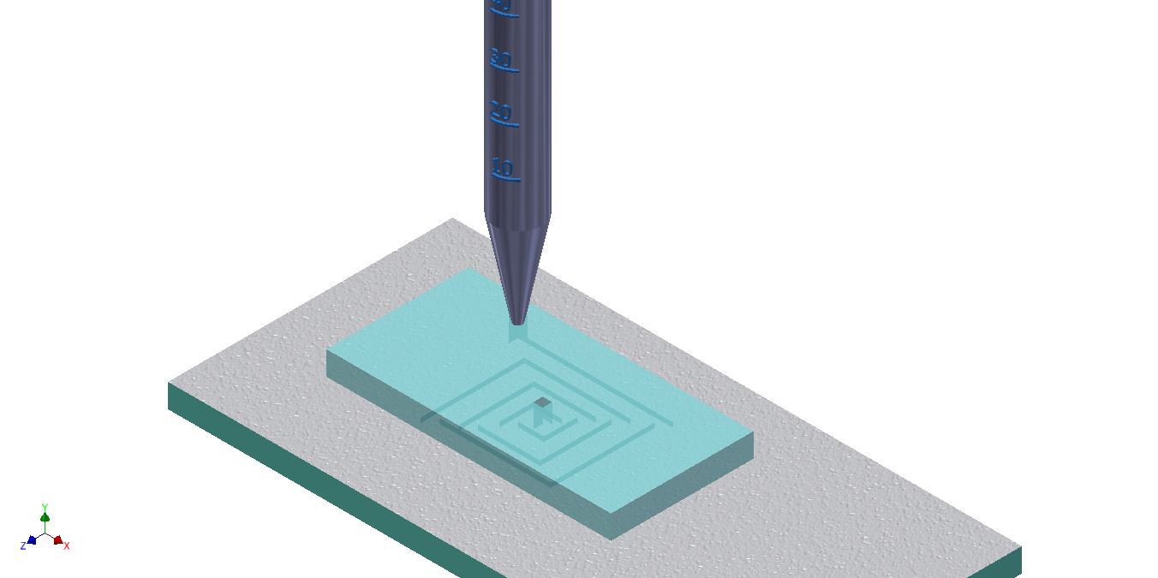
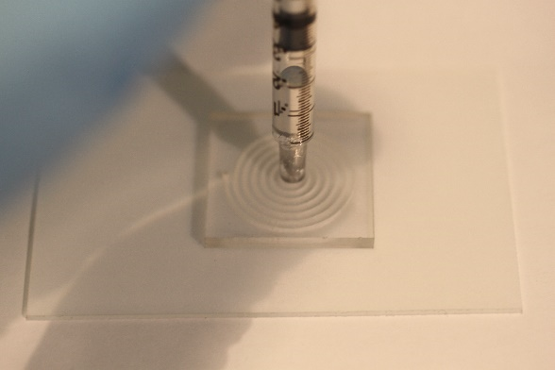
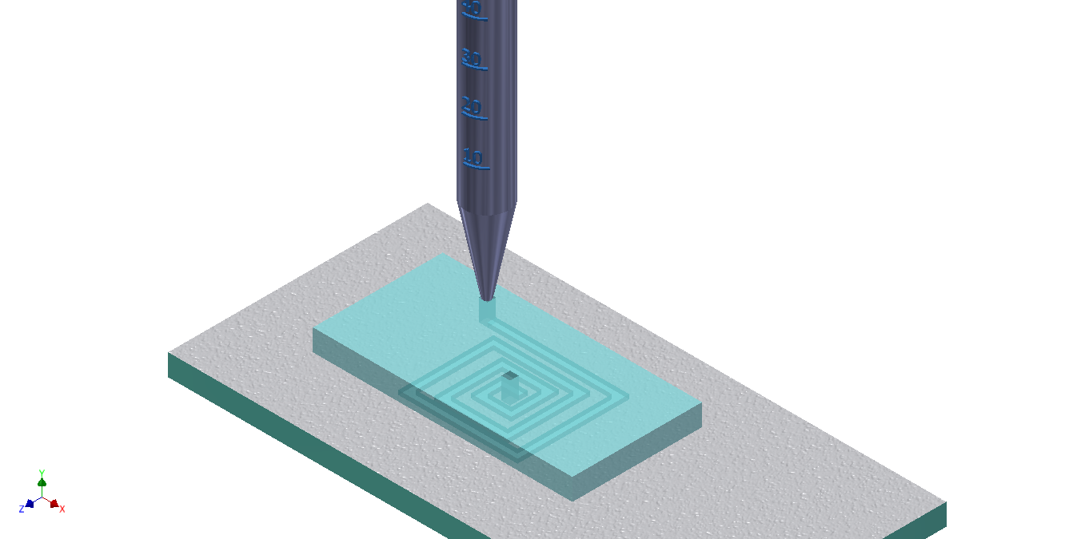
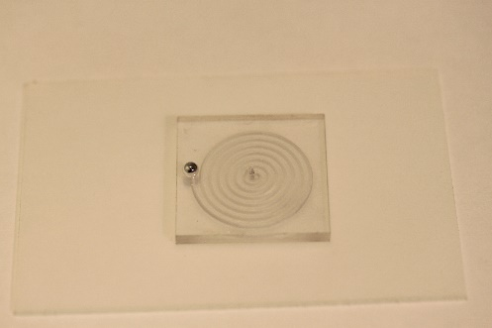
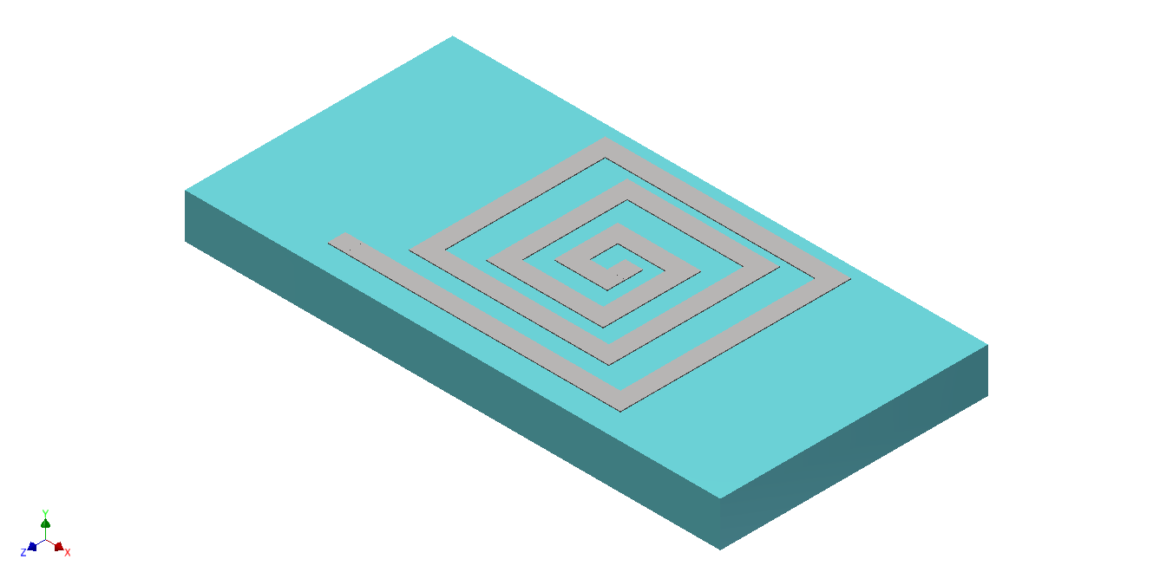
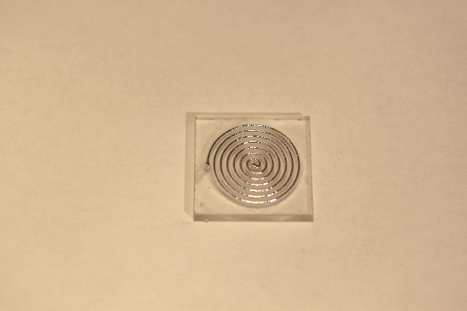
Pattern microchannel on substrate via laser cutter
(i)
Place upside down on NeverWet Coated Glass
(ii)
(iii)
Inject EGaIn into inlet hole
Remove substrate from glass
(iv)
(v)

Slide 2
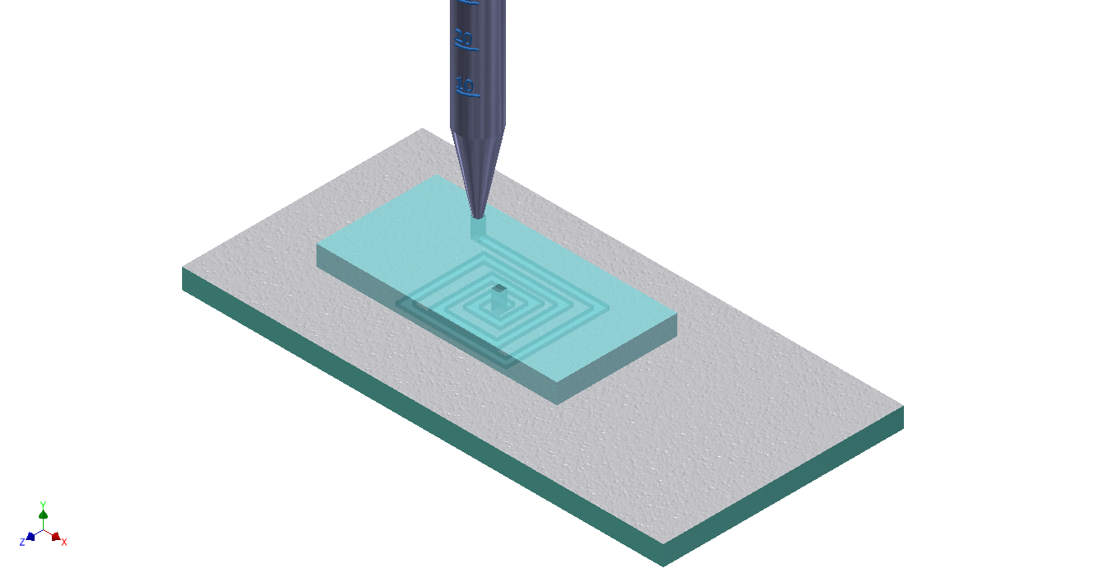
Pattern microchannel on substrate via laser cutter
(i)
Place upside down on NeverWet Coated Glass, Inject EGaIn into inlet hole
(ii)
(iii)
Remove substrate from glass
(iv)

Slide 3
Pattern microchannel
Place against NeverWet slide (Pattern face down)
(i)
Substrate
(ii)
(iii)
Inject EGaIn via inlet
Remove NeverWet slide
(iv)
(v)
(vi)

Slide 4
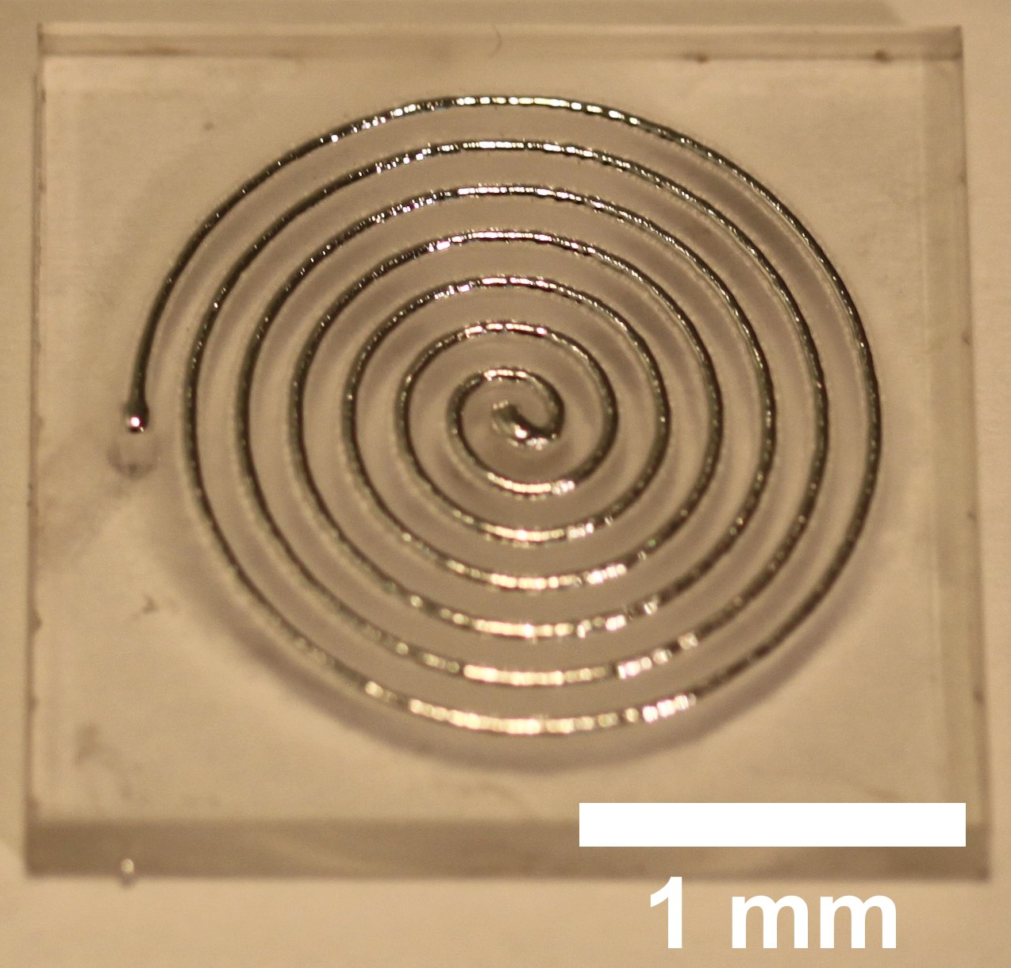
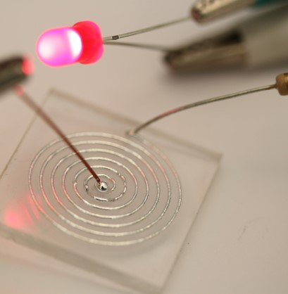
Place against NeverWet slide (pattern face down), inject EGaIn into inlet
Laser pattern microchannel
(i)
PDMS
(iii)
(ii)
Remove NeverWet slide
Result
(iv)
(v)

Slide 5
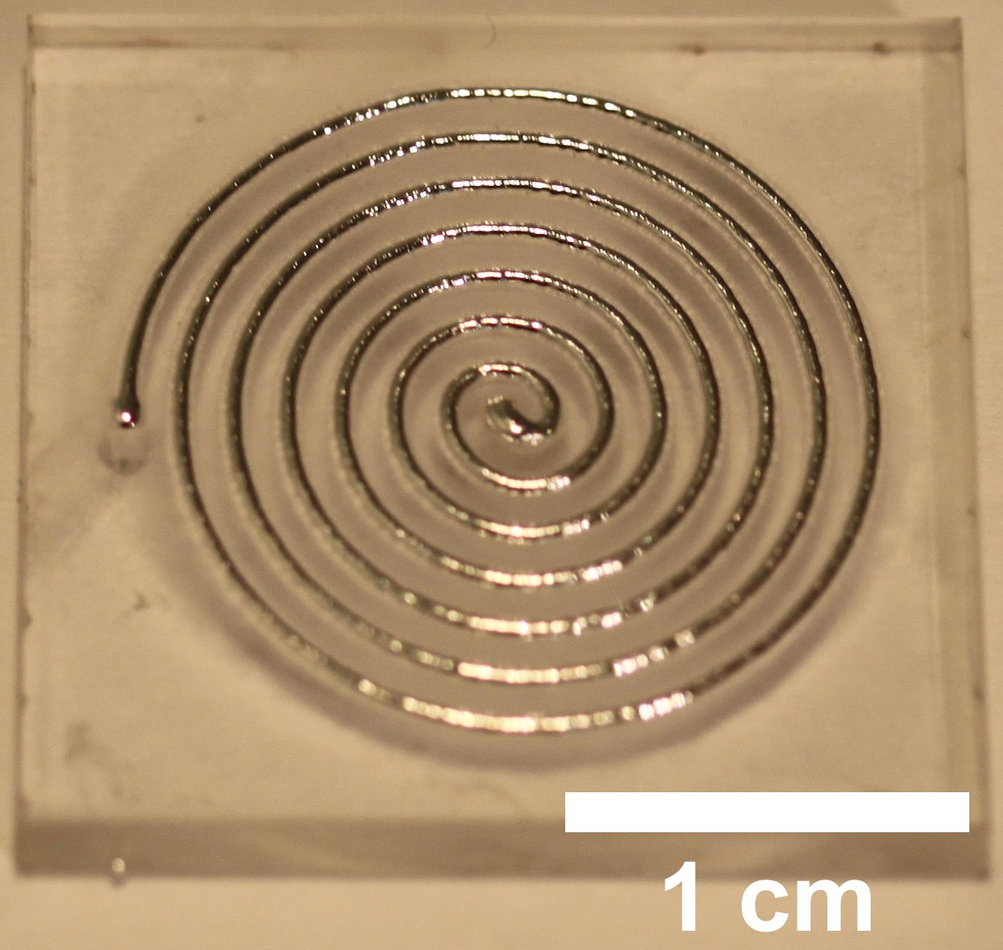
Place against NeverWet slide (pattern face down), inject EGaIn into inlet
Laser pattern microchannel
(i)
PDMS
(iii)
(ii)
Remove NeverWet slide
Result
(iv)
(v)

